Slide 1

Unit 3 Aggregate demand and the multiplier model
How economies fluctuate between booms and recessions as they are continuously hit by good and bad shocks
PART 2

Slide 2
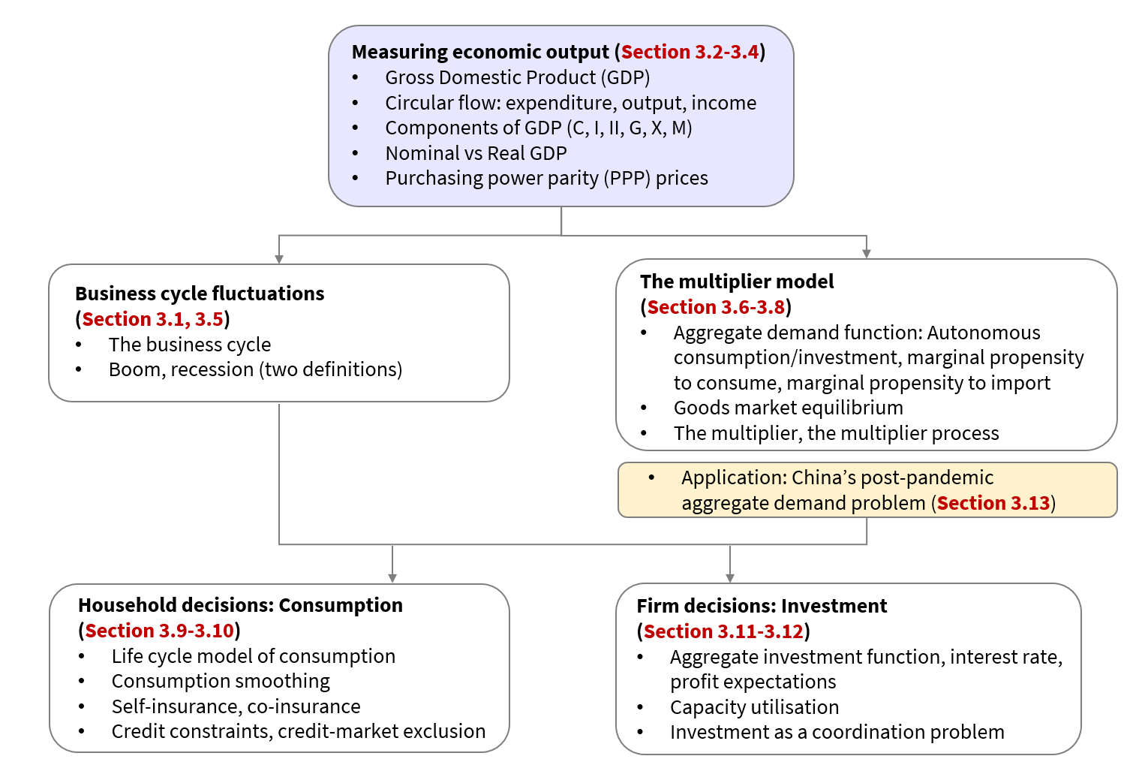
Topic ❶
Topic ❷
Topic ❸
3.7 The multiplier model: Aggregate demand shocks cause business cycle fluctuations

Slide 3
The private economy Focus: Investment
𝑎₀ is autonomous investment
AD = C + I
= c₀ + c₁Y + I
planned investment expenditure that does not depend on other variables in the model
=
𝑎₀ – 𝑎₁r
𝑎₁ shows investment’s sensitivity to the interest rate

Slide 4
More on Investment
where 𝑎₀ is autonomous investment⁠: In a model of investment demand, autonomous investment is (such as income, or the interest rate), and 𝑎₁ reflects how sensitive investment is to the interest rate.
Ceteris paribus, we assume that a higher interest rate reduces investment spending. At this stage, we simply focus on the basic intuition that a higher cost of borrowing for firms will make them less willing to borrow the funds they need to undertake investment.
All of the influences on investment apart from the interest rate are included in the autonomous investment, 𝑎0
Notes:
Student slide

Slide 5
Assume r increases from r to r′…
AD_{initial} = C + I
= c₀ + c₁Y + 𝑎₀ – 𝑎₁r
AD_{new} = c₀ + c₁Y + 𝑎₀ – 𝑎₁r′
r  I  AD
AD_{new} < AD_{initial}

Slide 6
A rise in r graphically

Slide 7
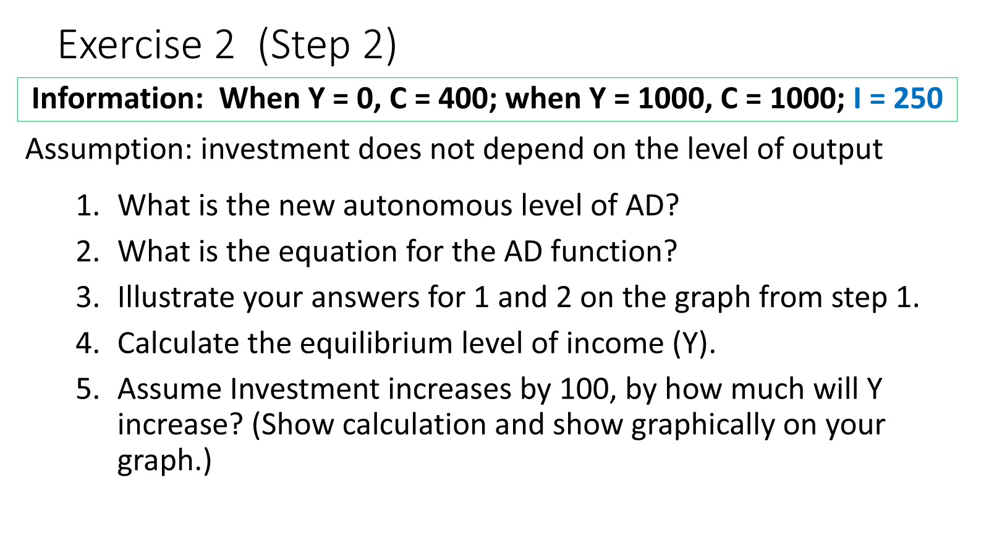
In step 2 of our exercise, I increased ….
But HOW does the multiplier work with an I shock?

Slide 8
An aggregate demand shock: A fall in investment
Remember: ∆c₀ or ∆I displace the old equilibrium (Y) since they ∆AD, which in turn alters the level of Y and N
∆AD₀  ∆Y
Assume I decreases by 15bn euros in figure 3.15

Slide 9
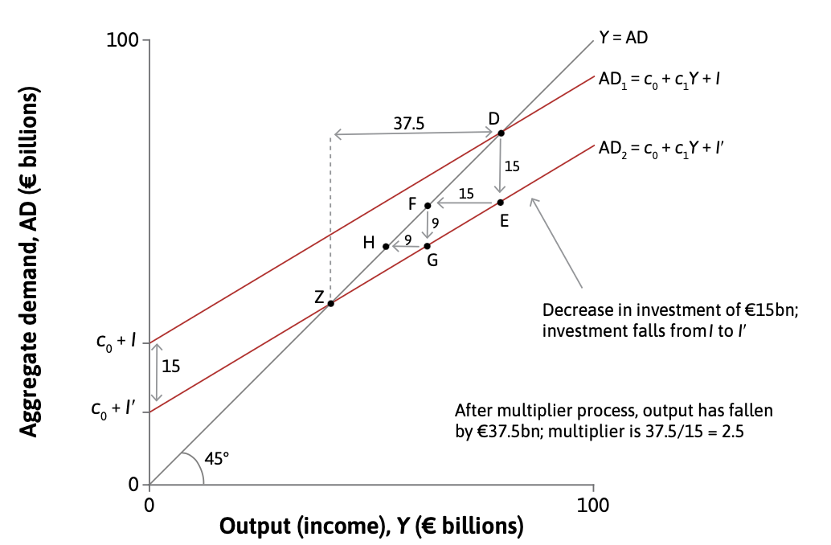
Summary: An aggregate demand shock: A fall in investment
Remember: when ∆Y ∆AD = MPC x ∆Y
∆I = €15 billion
economy moves vertically downward from D to E. E is not an equilibrium (not on 45-degree line)
AD is below output – increase in unsold goods (change in inventories positive) – national accounts identity still holds at E
since demand lower; unsold goods piling up – firms cut back production and reduce N
with output and N lower, incomes fall by €15 billion
This is the move from E to F
Less output produced and sold – fewer people are employed – households’ incomes fall – reduce consumption
C initially falls by 0,6 x ∆Y
This is the distance from F to G
Output , economy moves from G to H
The process will go on until the economy reaches point Z
This is where the new AD line crosses the 45-degree line—it is the new equilibrium

Slide 10
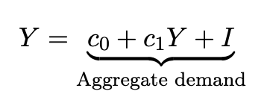
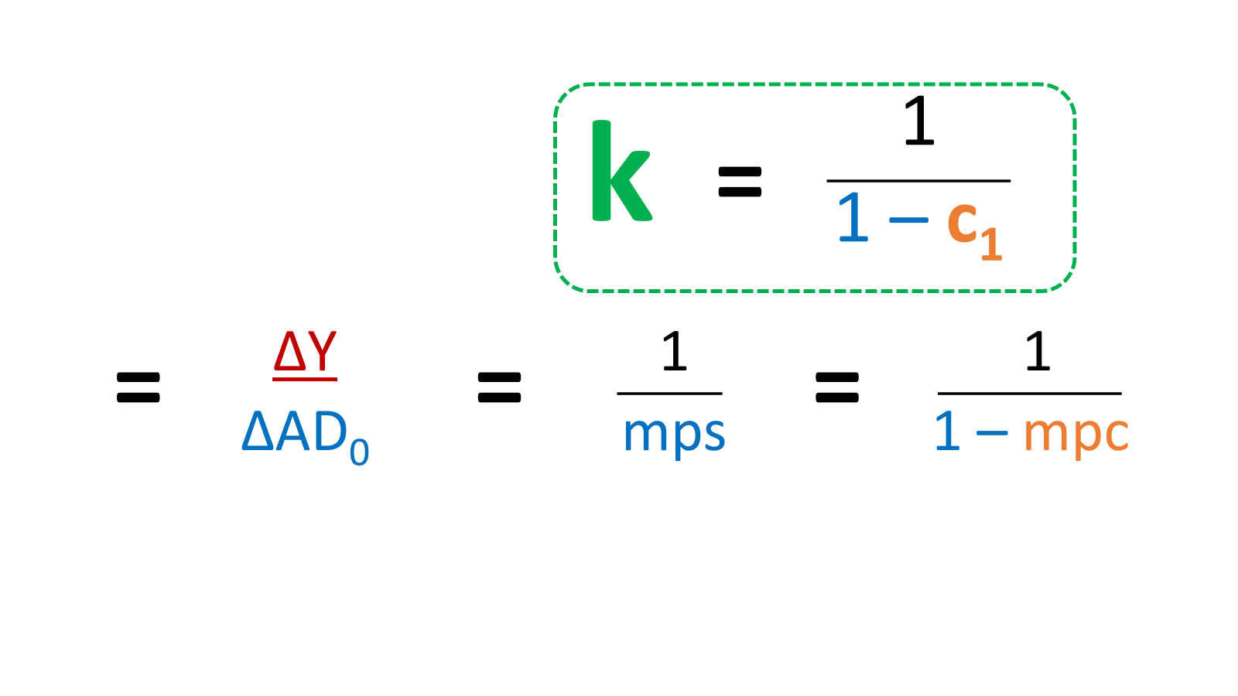
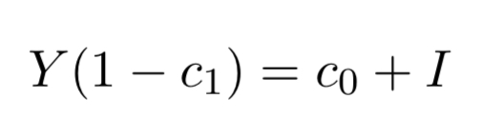
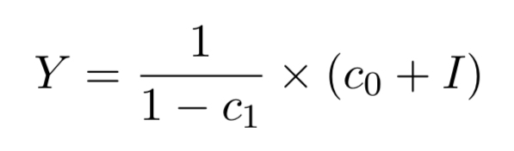
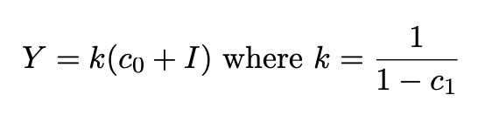
Calculating the multiplier: the private economy

Slide 11

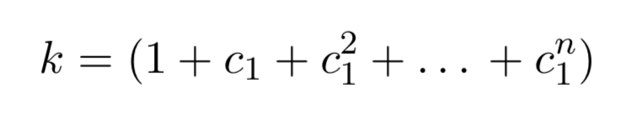
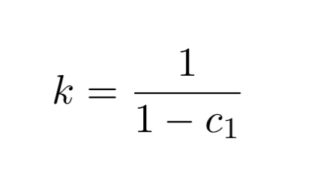
Calculating the multiplier: the private economy
For example, suppose investment changes by an amount ΔI:

Slide 12

Calculating the multiplier: the private economy

Slide 13
Do Question 3.9

Slide 14
Topic ❶
Topic ❷
Topic ❸
3.8 The multiplier model: Including the government and net exports

Slide 15
In Part 1 we looked at the multiplier model in a private economy (only C and I). We are now (Part 2) going to expand our model by adding other components of GDP (government, net exports). We are then moving from a closed to an open economy.
South Africa is an open economy and very dependent on imports such as oil.

Slide 16
Aggregate demand
Aggregate demand (AD) is the total demand that comes from households, firms, the government, and other countries for the goods and services the country produces.
AD = C + I + G + NX
PART 1
PART 2

Slide 17
Adding Government expenditure (G) – working with a closed(public) economy model ….

Slide 18
Adding only government expenditure to our model means that we still are working with a closed economy (C, I, G).

Slide 19
Unit 3
Now first do exercise 3 (step 3) of the comprehensive exercise ….
Comprehensive Calculation Exercise

Slide 20
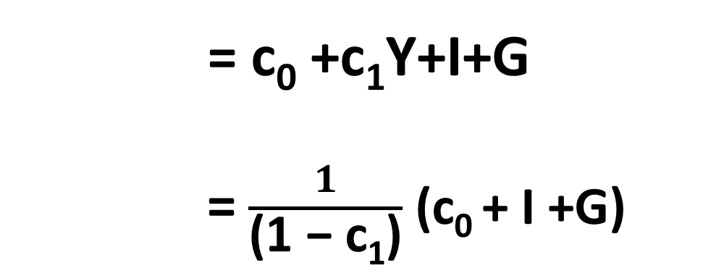
We now add government spending (taxes = 0) to consider this closed economy
AD = C + I + G = Y
= c₀ +c₁Y+I+G
= $\frac{1}{\text{(1 − }\text{c}\text{1}\text{)}}$ (c₀ + I +G)
Notes:
We start by adding G without any taxes

Slide 21
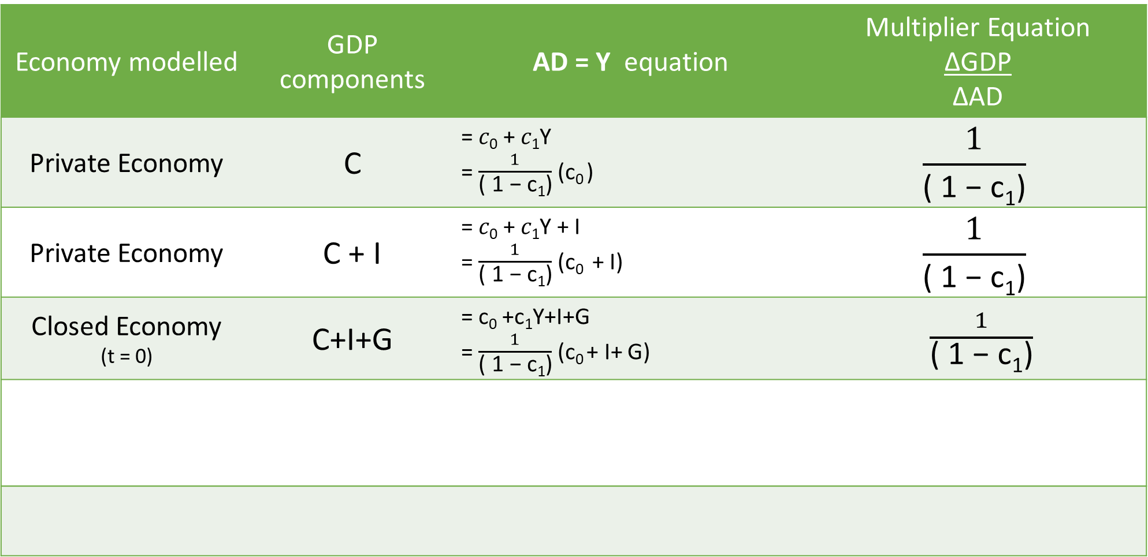
Economy modelled | GDP components | AD = Y equation | Multiplier Equation ∆GDP ∆AD
Private Economy | C | = 𝑐₀ + 𝑐₁Y = $\frac{1}{\text{( 1 − }\text{c}\text{1}\text{)}}$ (c₀ ) | $$\frac{1}{\text{( 1 − }\text{c}\text{1}\text{)}}$$
Private Economy | C + I | = 𝑐₀ + 𝑐₁Y + I = $\frac{1}{\text{( 1 − }\text{c}\text{1}\text{)}}$ (c₀ + I) | $$\frac{1}{\text{( 1 − }\text{c}\text{1}\text{)}}$$
Closed Economy (t = 0) | C+I+G | = c₀ +c₁Y+I+G = $\frac{1}{\text{( 1 − }\text{c}\text{1}\text{)}}$ (c₀ + I+ G) | $\frac{1}{\text{( 1 − }\text{c}\text{1}\text{)}}$

Slide 22
Exercise 3 (Step 3)
Information:
When Y = 0, C = 400; when Y = 1000, C = 1000; I = 250; G = 100
What is the equation for the AD function?
What will happen to Y if government spending increases by 200?
Where is the new level of equilibrium income?
Use a graph to illustrate your answers.

Slide 23
But for G to happen – T is necessary ….
C depends on post-tax income – i.e. disposable income – Y_{d}
government charges a tax, 𝑡, which we assume is proportional to income
T = tY
Y - T
=
=
(1 – t) Y
C changes in the 3 sector model with income tax being charged:
C = c₀ + c₁Y_{d}
C = c₀ + c₁(1 – t) Y

Slide 24
AD = C + I + G
Government enters AD via:
Government expenditure (G): exogenous; shifts AD curve upwards
Consumption (C): household’s MPC relates to disposable income (1-t)Y
Investment (I): depends on the interest rate and after-tax rate of profit

Slide 25

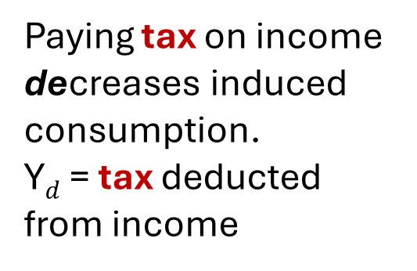
Adding the government to aggregate demand: the components
Paying tax on income decreases induced consumption. Y$d$ = tax deducted from income
AD = C + I + G
Consumption (C):
C = $c_{0}$ + $c_{1}$(1 - t) Y
disposable income (Y_{d})
autonomous consumption
MPC
income
tax

Slide 26
Unit 3
Now first do exercise 4 (step 4) of the comprehensive exercise ….
Comprehensive Calculation Exercise

Slide 27
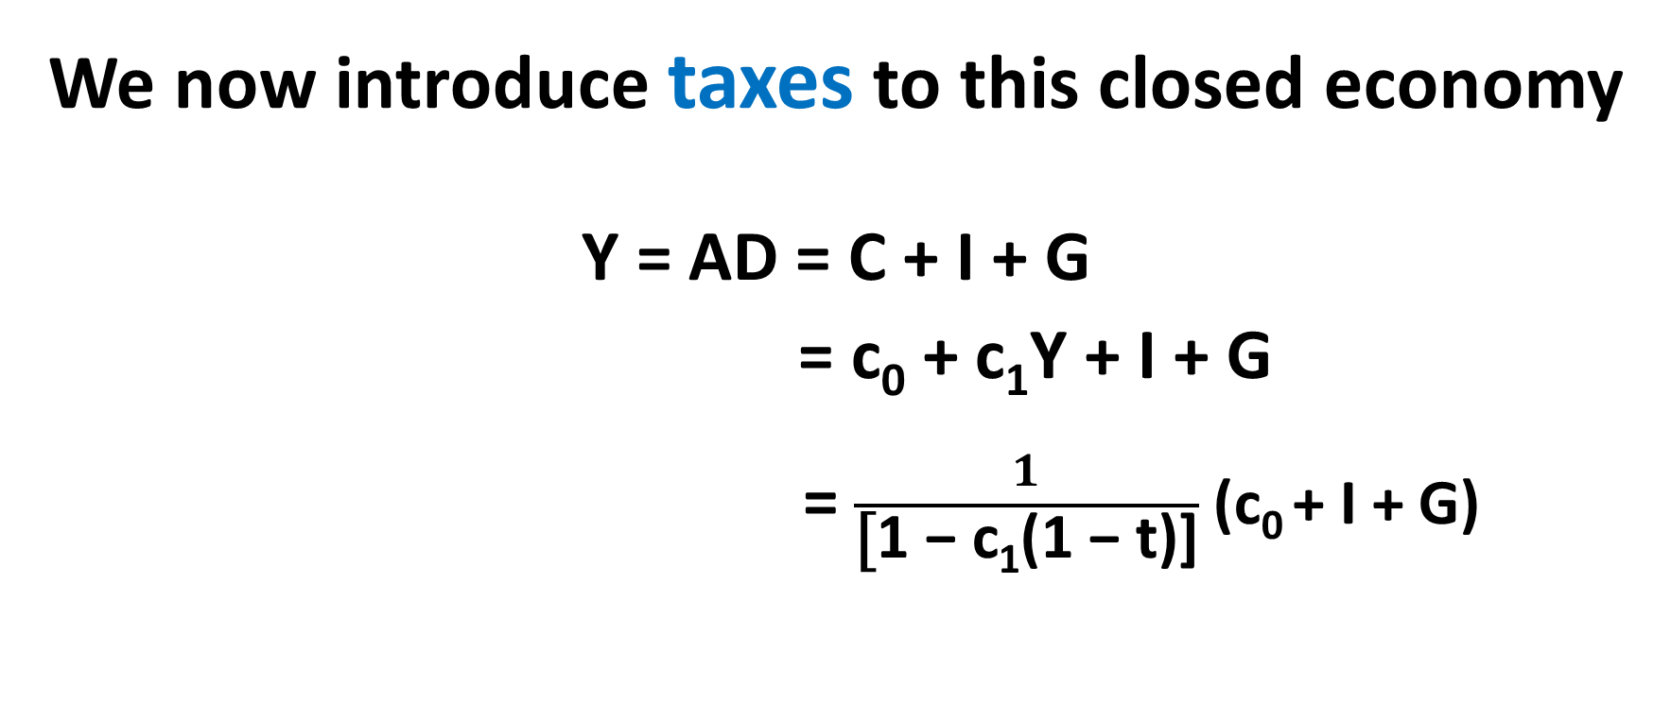
We now introduce taxes to this closed economy
Y = AD = C + I + G
= c₀ + c₁Y + I + G
= $\frac{1}{\text{[}\text{1 − }\text{c}\text{1}\text{(1 − }\text{t}\text{)}\text{]}}$ (c₀ + I + G)

Slide 28
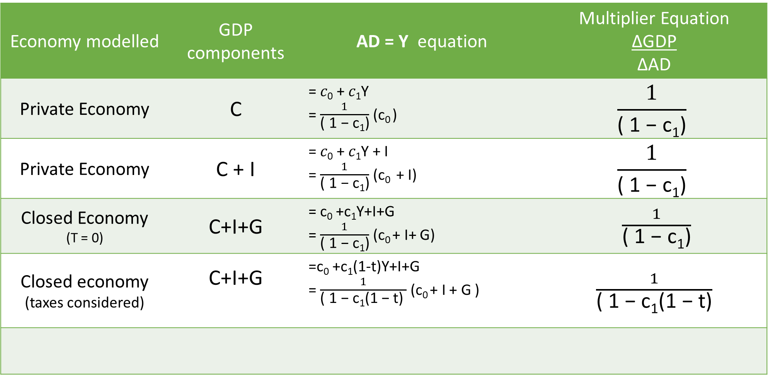
Economy modelled | GDP components | AD = Y equation | Multiplier Equation ∆GDP ∆AD
Private Economy | C | = 𝑐₀ + 𝑐₁Y = $\frac{1}{\text{( 1 − }\text{c}\text{1}\text{)}}$ (c₀ ) | $$\frac{1}{\text{( 1 − }\text{c}\text{1}\text{)}}$$
Private Economy | C + I | = 𝑐₀ + 𝑐₁Y + I = $\frac{1}{\text{( 1 − }\text{c}\text{1}\text{)}}$ (c₀ + I) | $$\frac{1}{\text{( 1 − }\text{c}\text{1}\text{)}}$$
Closed Economy (T = 0) | C+I+G | = c₀ +c₁Y+I+G = $\frac{1}{\text{( 1 − }\text{c}\text{1}\text{)}}$ (c₀ + I+ G) | $\frac{1}{\text{( 1 − }\text{c}\text{1}\text{)}}$
Closed economy (taxes considered) | C+I+G | =c₀ +c₁(1-t)Y+I+G = $\frac{1}{\text{( 1 − }\text{c}\text{1}\text{(1 − }\text{t}\text{) }}$ (c₀ + I + G ) | $\frac{1}{\text{( 1 − }\text{c}\text{1}\text{(1 − }\text{t}\text{)}}$

Slide 29
Exercise 4 (Step 4)
Information:
When Y = 0, C = 400; when Y = 1000, C = 1000; I = 250;
G = 100; t = 0,15
What is the equation of the AD function?
Calculate the value of the multiplier.
What will happen if G decreases by 50; what will be the change in Y?
Where is the new equilibrium level of income?
Use a graph to illustrate your answers.

Slide 30
Effect of tax on the multiplier:
Try this Question
Information: When Y= 0, C = 400 and when Y = 1000, C = 1000, I = 500, G = 600 and the tax rate is 25%
Determine and graphically illustrate the AD function in the goods market
Calculate the multiplier without Government expenditure
Calculate the multiplier in a 3 sector model
Describe the effect tax had on the function of the multiplier.

Slide 31
Assume t decreases from t to t′
∆𝑡 to 𝑡′ increases the size of the multiplier
(more household income is available to spend on goods and services)
AD is steeper
indirect effects of any changes in the intercept (𝑐₀, 𝑎₀, 𝐺, 𝑋, 𝑟)
on Y and N are now larger
new goods market equilibrium is at a higher level of output

Slide 32
Assume t decreases from t to t′ graphically
Notes:
A fall in the tax rate (from 𝑡 to 𝑡′) increases the size of the multiplier, because more household income is available to spend on goods and services. Ceteris paribus, the aggregate demand curve is steeper, meaning that the indirect effects of any changes in the intercept (𝑐0, 𝑎0, 𝐺, 𝑋, 𝑟) on output and employment are now larger. The new goods market equilibrium (Dnew𝑡) is at a higher level of output

Slide 33
Opening up the economy:
When we move from a closed to an open economy Exports (products manufactured in the country) and Imports (products manufactured in other countries) come into play.
As income increases so does imports – we therefore have a
marginal propensity to import (m)

Slide 34
Adding Net Exports (NX = X – M) – working with an open economy model ….

Slide 35
Net Exports (NX) = EXports - IMports
Adding net exports to our model means that we are working with an open economy (C, I, G, NX).

Slide 36
Net exports and aggregate demand
AD = C + I + G + NX
NX = exports - imports
Exports are taken as exogenous.
Imports depend on domestic income.
Marginal propensity to import (m)= The fraction of each additional unit of income that is spent on imports

Slide 37
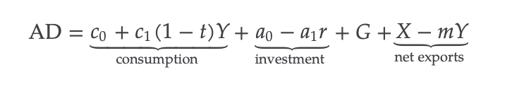
Adding government to aggregate demand: the components
Consumption (C)
+ Planned Investment (I)
+ Government expenditure (G)
+ Net exports (NX):
net exports = X – M
= X – mY
X = Exports
M = Imports
m = marginal propensity to import
Y = Income

Slide 38
Unit 3
Now first do exercise 5 (step 5) of the comprehensive exercise ….
Comprehensive Calculation Exercise

Slide 39

We now net exports (X-M), and the economy becomes an open economy
AD = Y
= c₀ + c₁Y + I + G + NX
= $\frac{1}{\text{( 1 − }\text{c}\text{1}\text{(1 − }\text{t}\text{) + }\text{m}\text{)}}$ (c₀ + I + G + X)

Slide 40
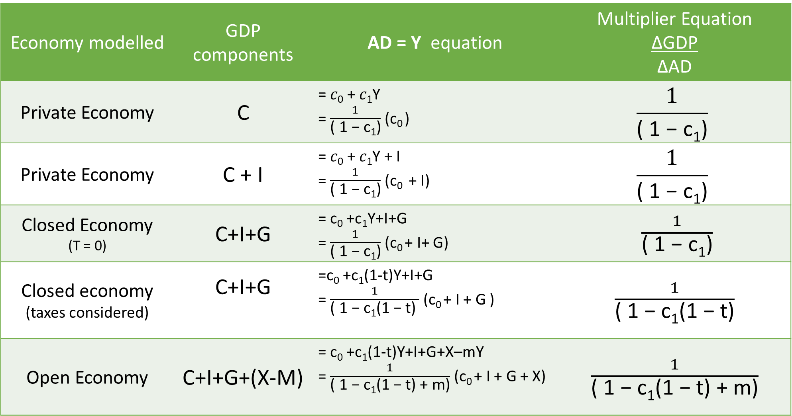
Economy modelled | GDP components | AD = Y equation | Multiplier Equation ∆GDP ∆AD
Private Economy | C | = 𝑐₀ + 𝑐₁Y = $\frac{1}{\text{( 1 − }\text{c}\text{1}\text{)}}$ (c₀ ) | $$\frac{1}{\text{( 1 − }\text{c}\text{1}\text{)}}$$
Private Economy | C + I | = 𝑐₀ + 𝑐₁Y + I = $\frac{1}{\text{( 1 − }\text{c}\text{1}\text{)}}$ (c₀ + I) | $$\frac{1}{\text{( 1 − }\text{c}\text{1}\text{)}}$$
Closed Economy (T = 0) | C+I+G | = c₀ +c₁Y+I+G = $\frac{1}{\text{( 1 − }\text{c}\text{1}\text{)}}$ (c₀ + I+ G) | $\frac{1}{\text{( 1 − }\text{c}\text{1}\text{)}}$
Closed economy (taxes considered) | C+I+G | =c₀ +c₁(1-t)Y+I+G = $\frac{1}{\text{( 1 − }\text{c}\text{1}\text{(1 − }\text{t}\text{) }}$ (c₀ + I + G ) | $\frac{1}{\text{( 1 − }\text{c}\text{1}\text{(1 − }\text{t}\text{)}}$
Open Economy | C+I+G+(X-M) | = c₀ +c₁(1-t)Y+I+G+X–mY = $\frac{1}{\text{( 1 − }\text{c}\text{1}\text{(1 − }\text{t}\text{) + }\text{m}\text{)}}$ (c₀ + I + G + X) | $\frac{1}{\text{( 1 − }\text{c}\text{1}\text{(1 − }\text{t}\text{) + }\text{m}\text{)}}$

Slide 41
Exercise 5 (Step 5)
Information: When Y = 0, C = 400; when Y = 1000, C = 1000; I = 250;
G = 100; t = 0,15, X=60, m=0,1
What is the new equation of the AD function?
Calculate the value of the multiplier.
What will happen if net exports decreases by 20; what will be the change in Y?
Where is the new equilibrium level of income?
Use a graph to illustrate your answers.

Slide 42
Assume m rises from m to m′
∆m decreases the size of the multiplier
(since less household income is spent on domestic goods and services)
AD is flatter
indirect effects of any changes in the intercept (𝑐₀, 𝑎₀, 𝐺, 𝑋, 𝑟)
on Y and N are now smaller
new goods market equilibrium is at a lower level of output

Slide 43
Assume m rises from m to m′ graphically

Slide 44
The multiplier
Previously, slope of AD curve was 𝑐₁, the MPC
Now, slope also depends on the tax rate, 𝑡, and the marginal propensity to import, 𝑚 — so they change the multiplier
X and G, in contrast, are now additional components of AD
Both taxes and imports reduce the size of the multiplier
Recall that the multiplier tells us the amount by which an increase in spending (such as a rise in c₀, I, G, or X) raises GDP (Y) in the economy
When we include taxation and imports in the model, the indirect multiplier effect of a given rise in spending on GDP is smaller

Slide 45
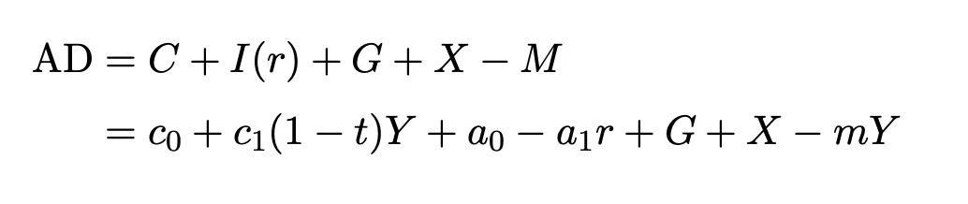
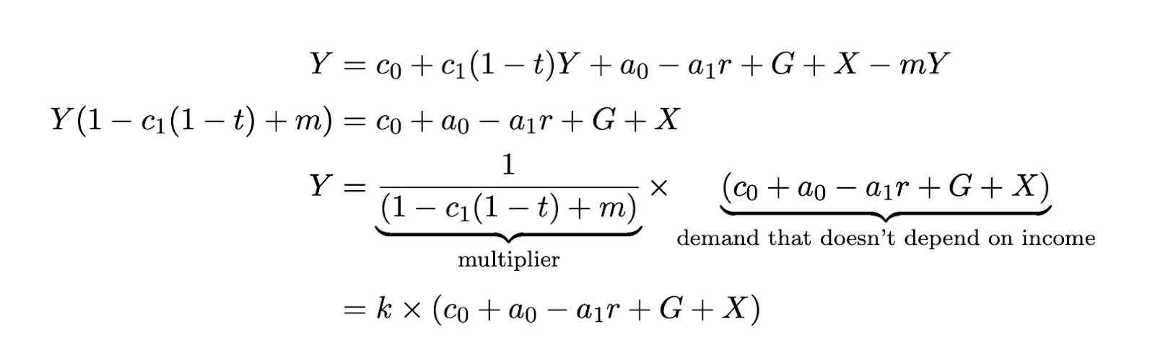
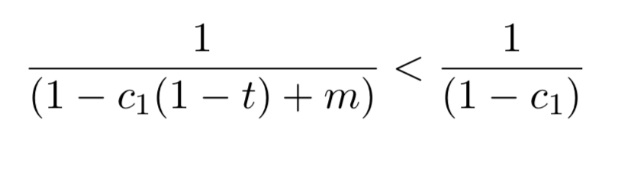
The multiplier in the full model

Slide 46
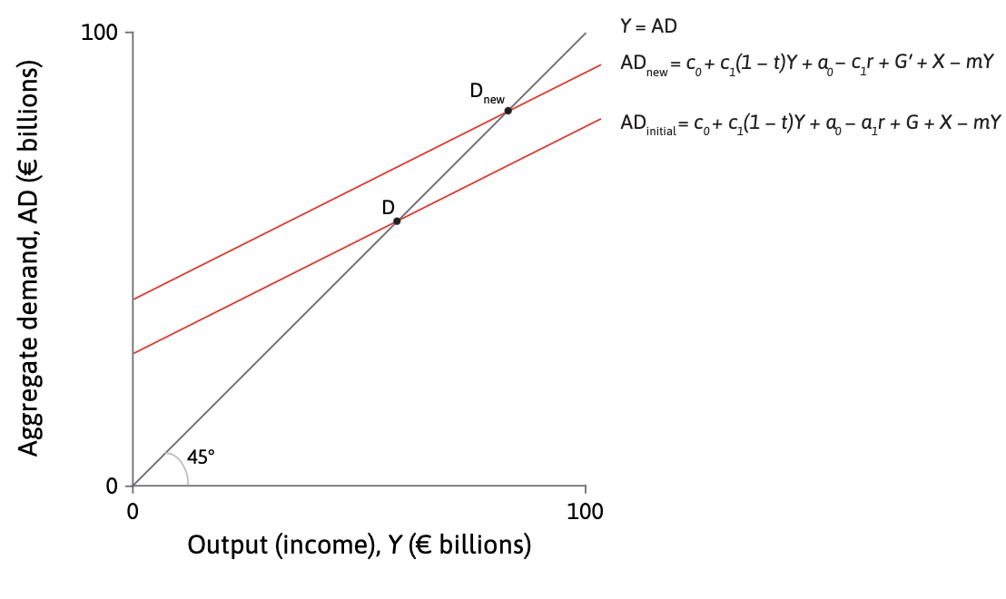
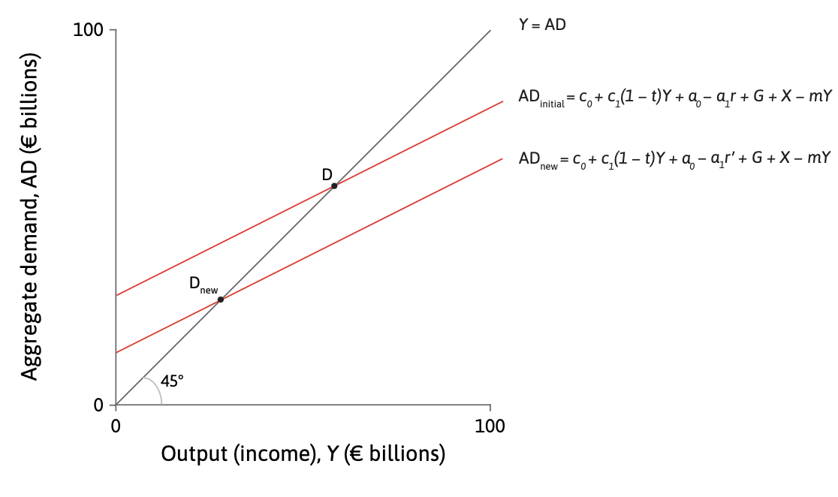
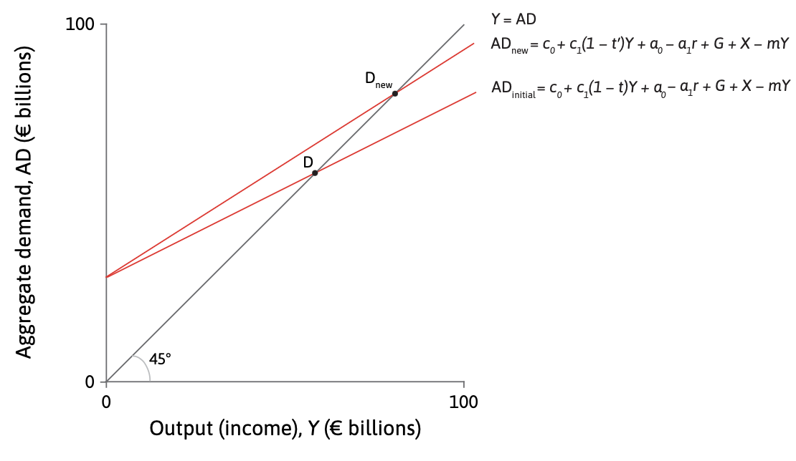
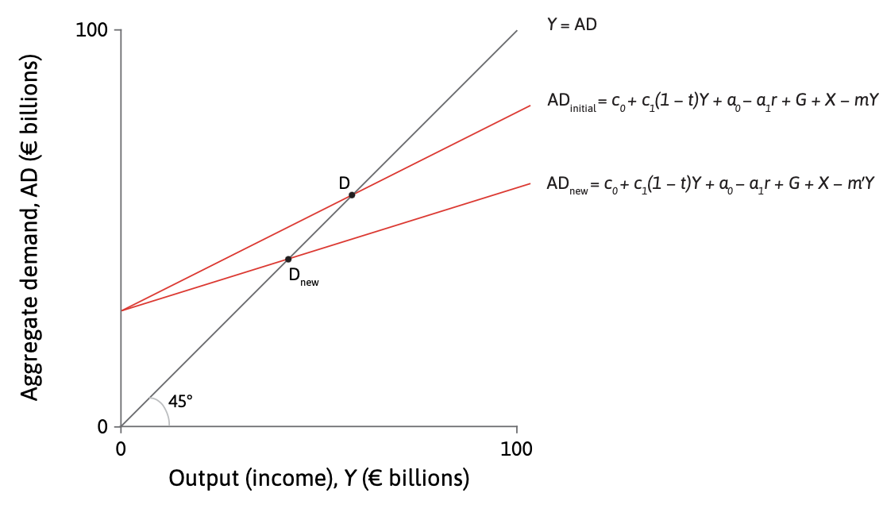
Summary of Changes in the AD curve
A rise in G
A rise in r
A fall in t
A rise in m

Slide 47
In summary…
A higher marginal propensity to import reduces the size of the multiplier: This makes the aggregate demand curve flatter.
An increase in the tax rate reduces the size of the multiplier: This also makes the aggregate demand curve flatter.
An increase in exports or government spending shifts the aggregate demand curve up in the multiplier diagram

